Slide 1
Make your own Roman Coin!
This activity works requires air drying clay and toothpicks.
You can also paint your coins once dried if you want to go one step further.
Grab a block of air-drying clay and mould into small coin blanks. Using toothpicks / cocktail sticks, carve your own design using our handy guides!

Slide 2
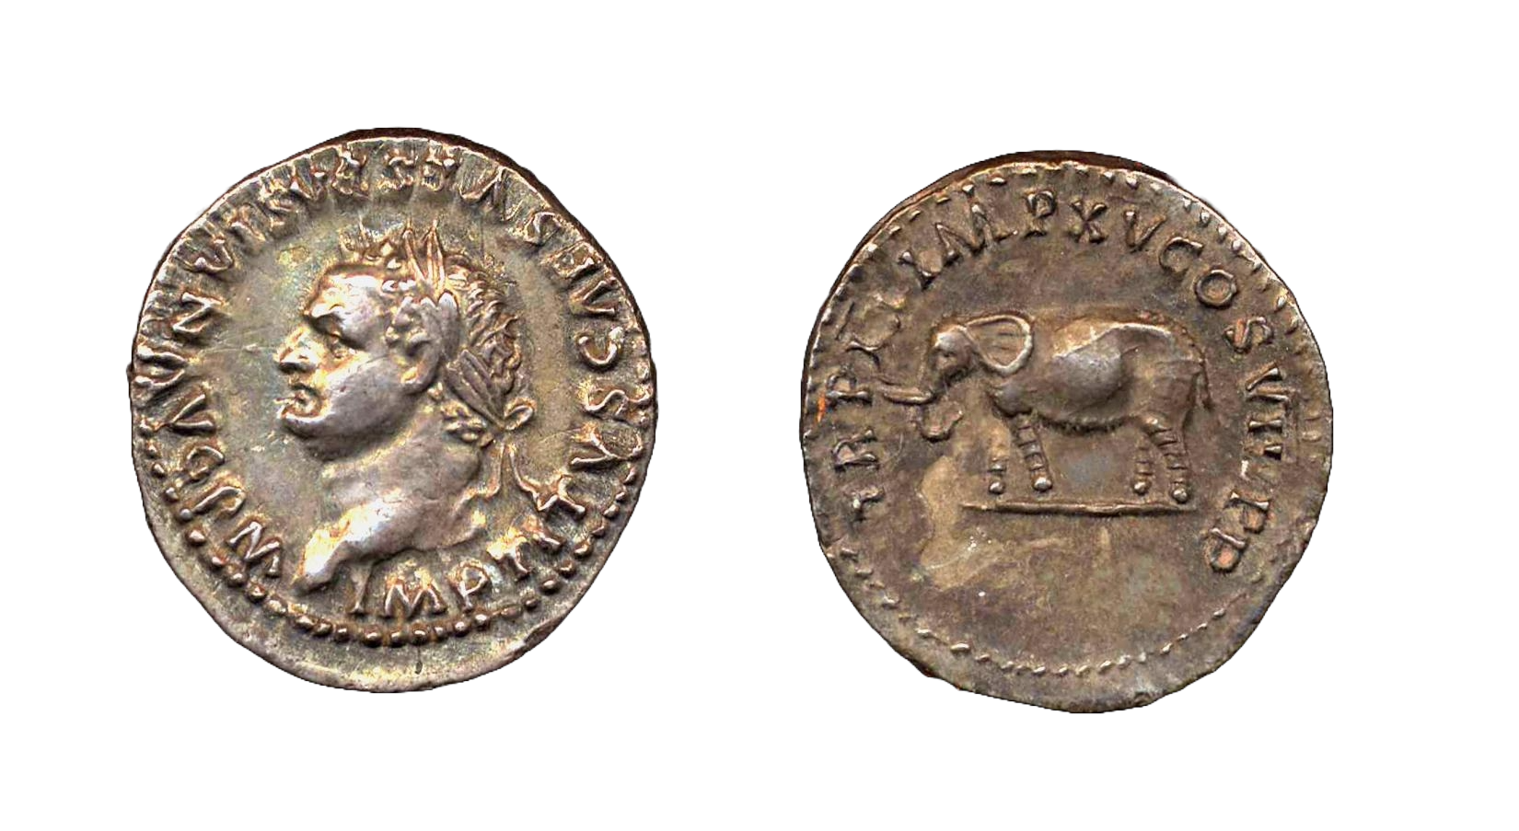
What does a Roman coin need on it?
Print out in A4 and laminate
Your name.
The most important part! Let everyone know who their mighty emperor is!
Tell them you are the emperor.
Many Roman coins say AVG – this is a shortening of Augustus, the name of the first Emperor!
Symbols.
Pick something that best symbolises you and your achievements. Many emperors chose animals or mythical figures!
Your face.
Many emperors wore a crown of laurel leaves to show their power, what crown would you wear?
More titles.
Let everyone know how important you are by listing your many many many titles. You might need to shorten them to make them all fit!

Slide 3
Print out in A4, cut into 2 sheets at A5 and laminate
What should I write on my coin?
What should I write on my coin?
Write Me: | I am short for: | Which means:
AVG | Augustus or Augusta | Name of the first emperor and used as a title by other emperors
C or CAES | Caesar | Family name of Julius Caesar and used as a title by other emperors
IMP | Imperator | Commander, commander-in-chief, or victorious general
P P | Pater Patriae | Father of the country
P F | Pius Felix | Dutiful to the gods and blessed by them
SPQR | Senatus Populus Que Romanus | The Senate and People of Rome
Write Me: | I am short for: | Which means:
AVG | Augustus or Augusta | Name of the first emperor and used as a title by other emperors
C or CAES | Caesar | Family name of Julius Caesar and used as a title by other emperors
IMP | Imperator | Commander, commander-in-chief, or victorious general
P P | Pater Patriae | Father of the country
P F | Pius Felix | Dutiful to the gods and blessed by them
SPQR | Senatus Populus Que Romanus | The Senate and People of Rome
Did you know? Titles used on coins are written in Latin, the language of the Roman Empire!
Did you know? Titles used on coins are written in Latin, the language of the Roman Empire!

Slide 4
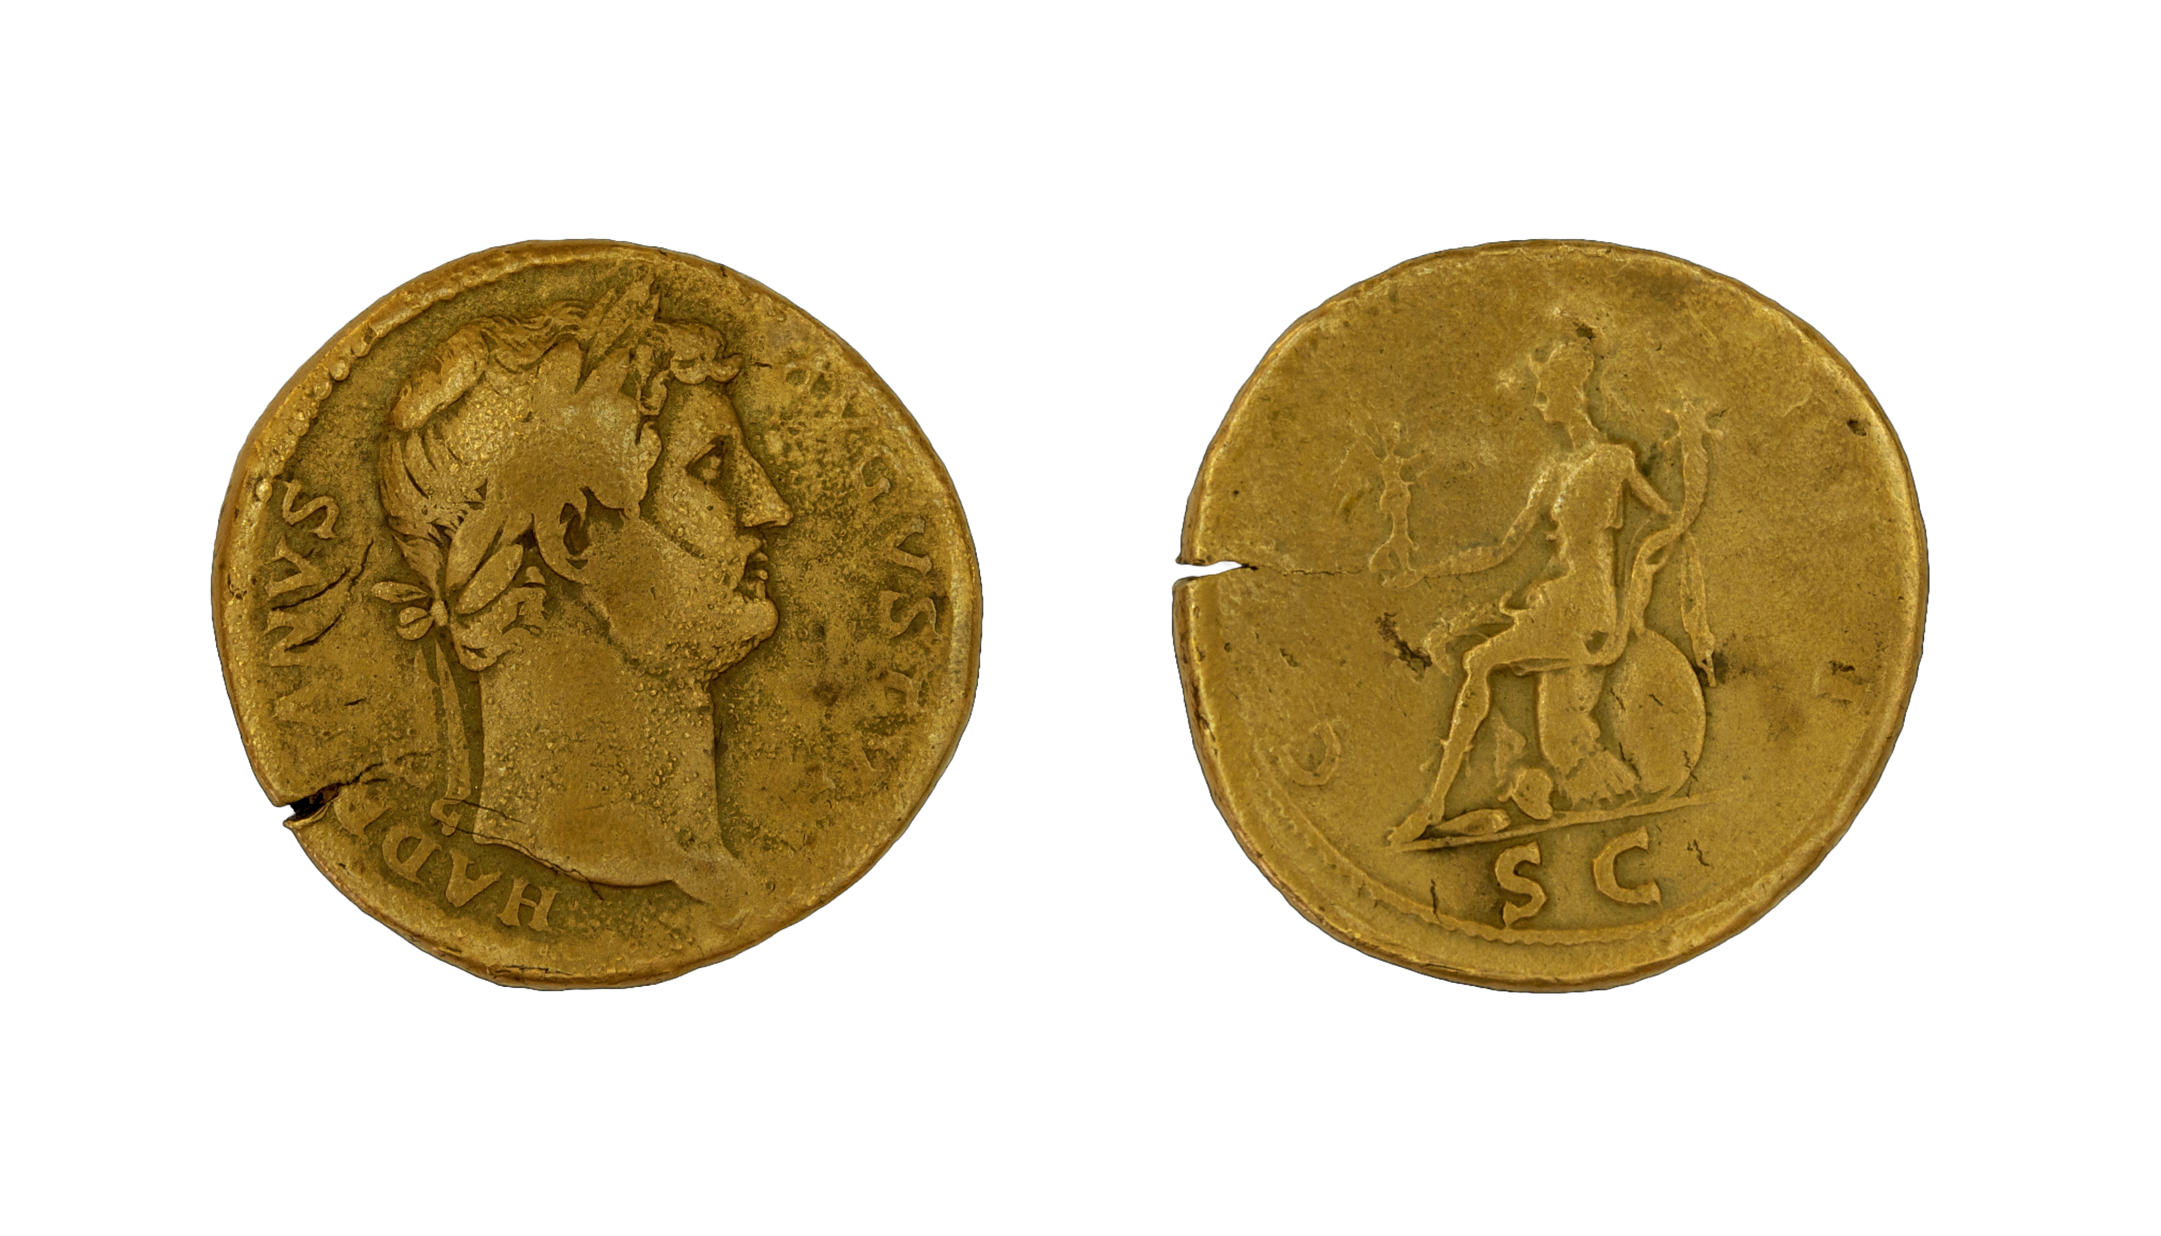
Print these A4, cut out and place back-to-back before laminating

Slide 5
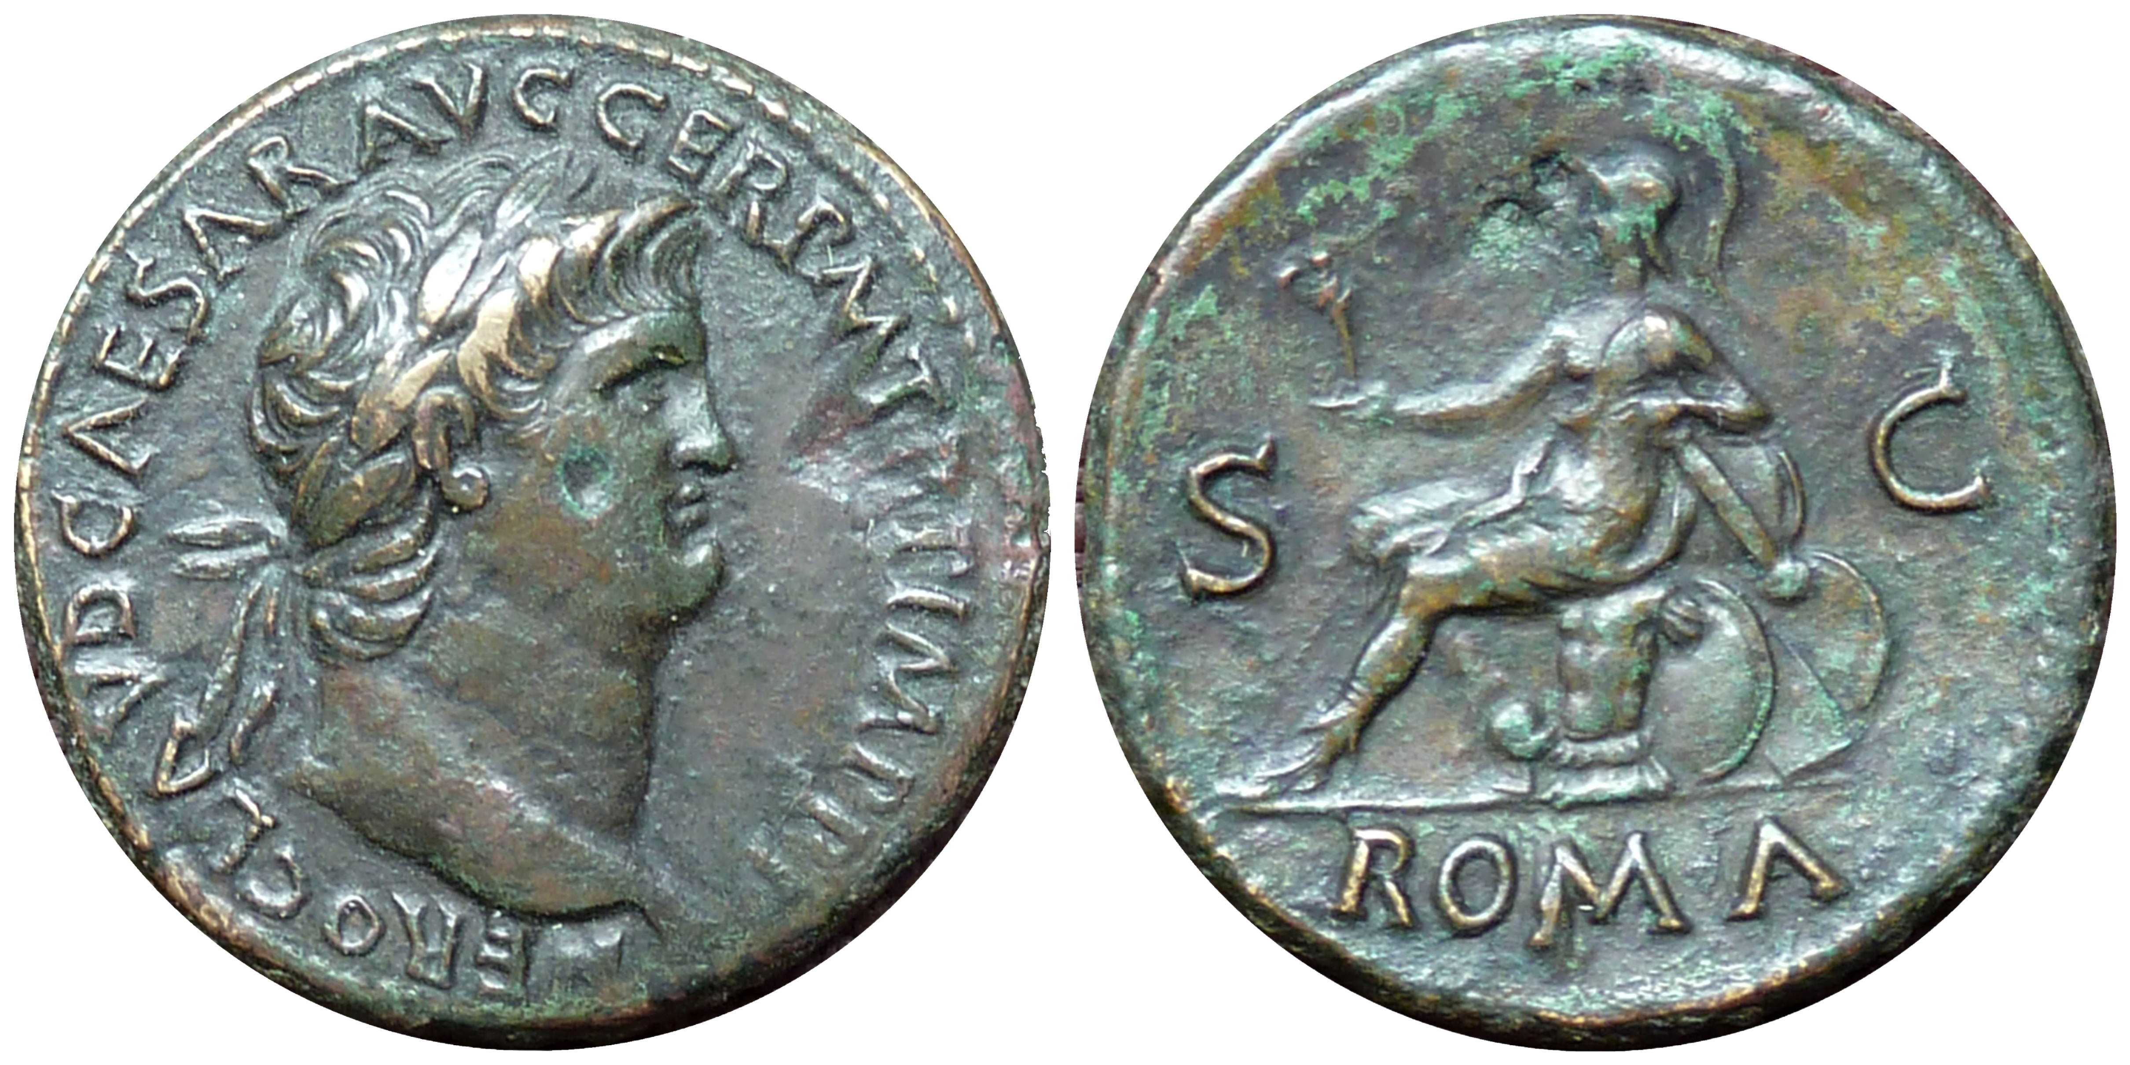
Print these A4, cut out and place back-to-back before laminating

Slide 6
Print these A4, cut out and place back-to-back before laminating

Slide 7
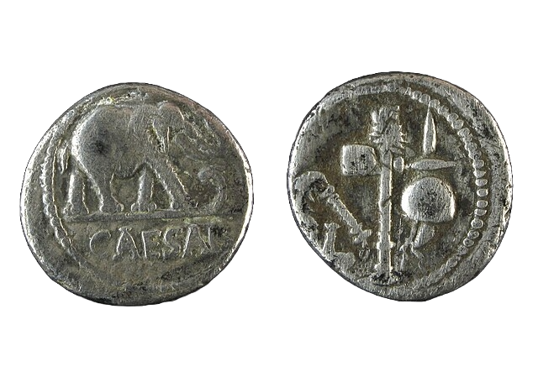
Print these A4, cut out and place back-to-back before laminating

Slide 8
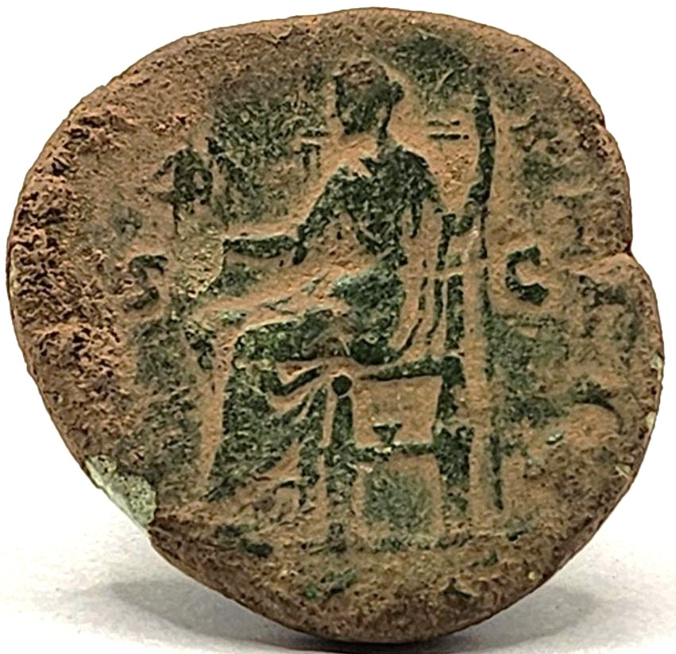
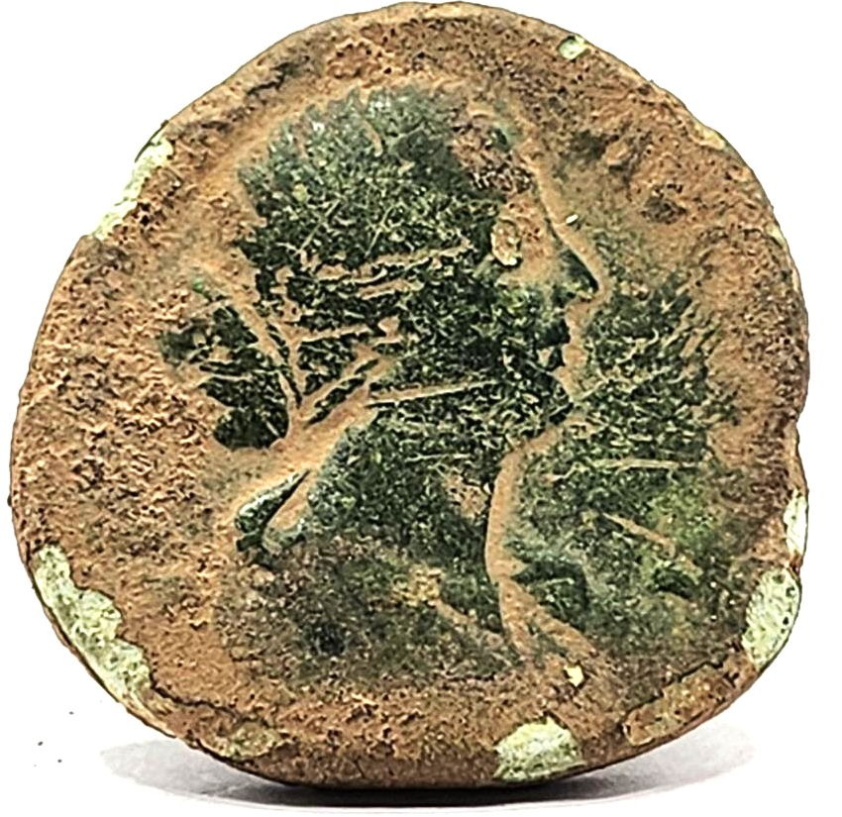
Print these A4, cut out and place back-to-back before laminating

