Slide 1
Where did this come from?
This activity works best with a map of Europe or the Roman Empire.
But can also be useful flash cards for learning about different objects.
You will need:
A map of Europe
Printed finds cards
The finds cards are on slides 2-5. The text matches the images in the slide above. You will need to print and stick them back-to-back.
Have a look at the pictures of things we have found on site at Brougham and match them up to where they may have come from across the Roman Empire!

Slide 2
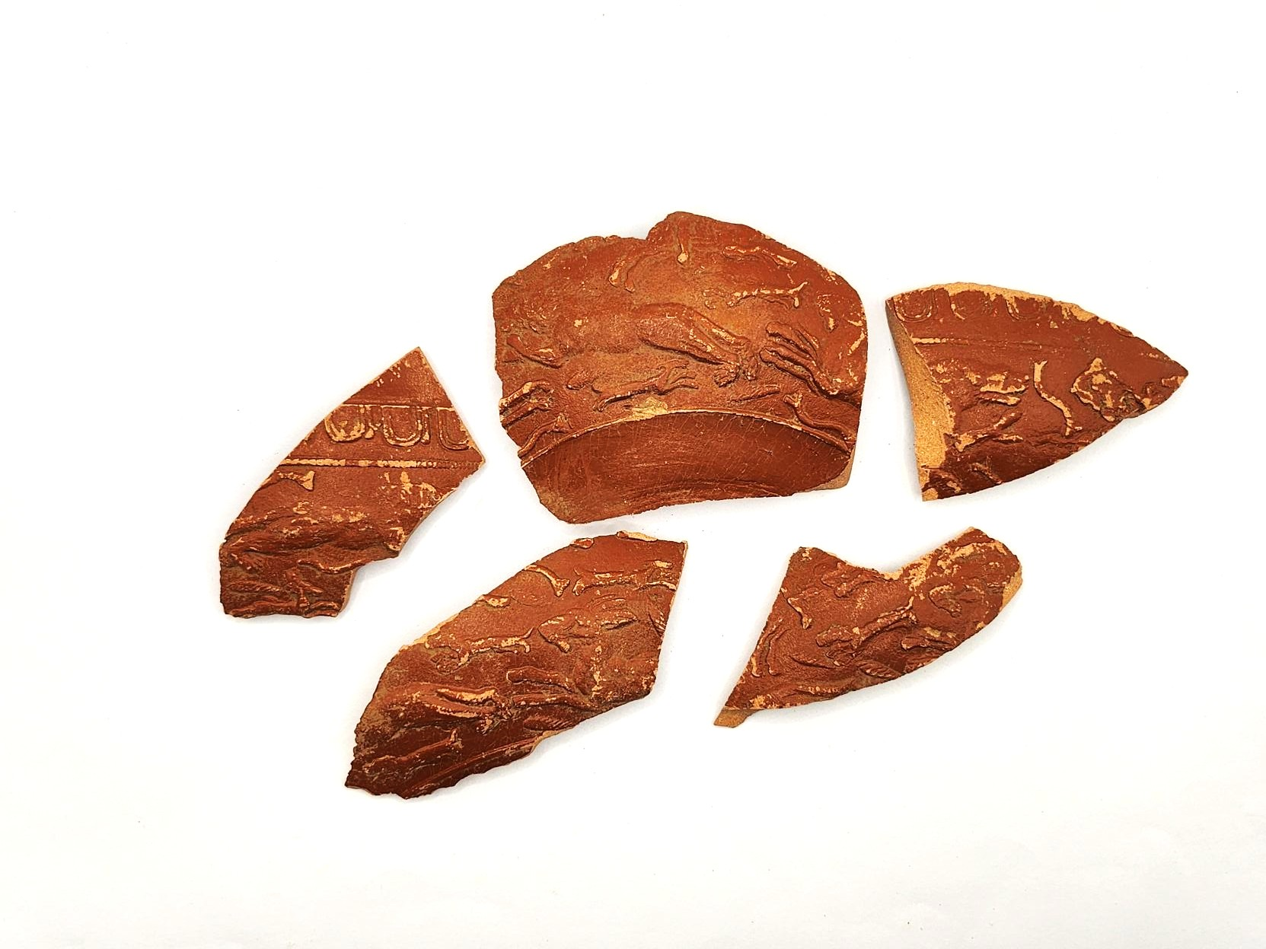
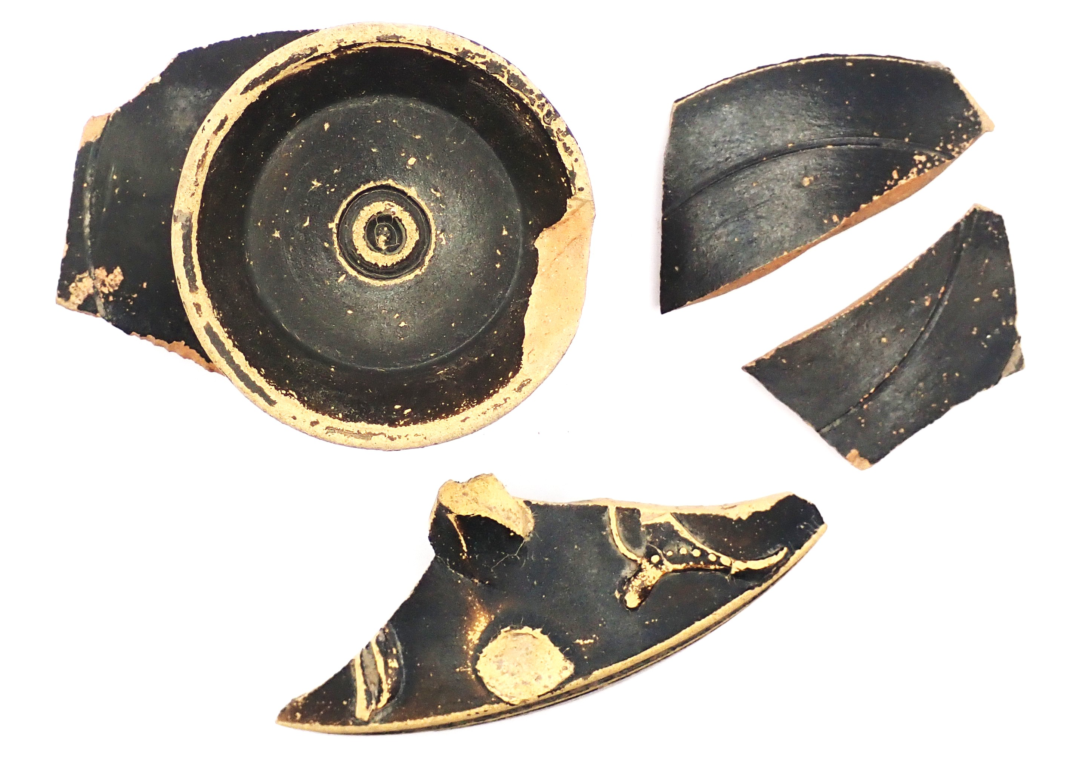
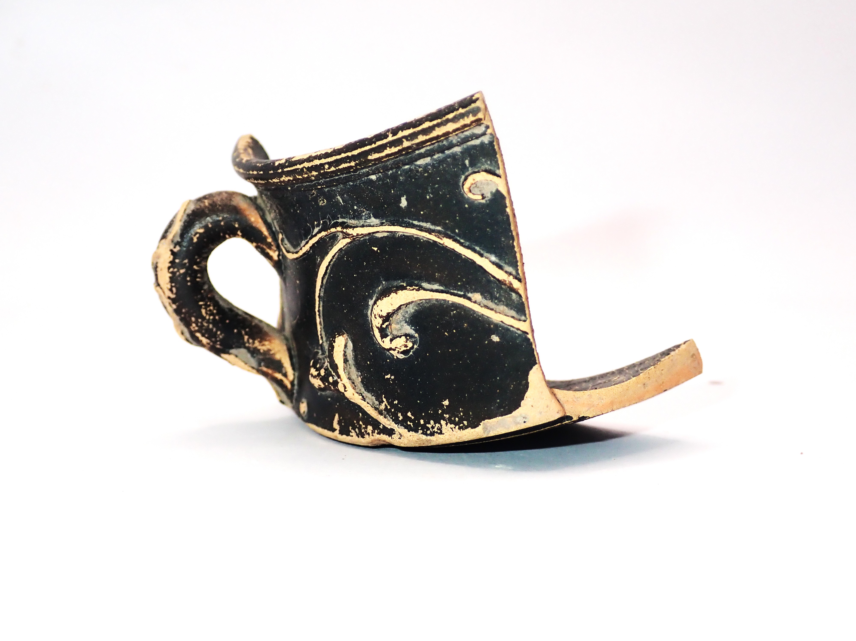
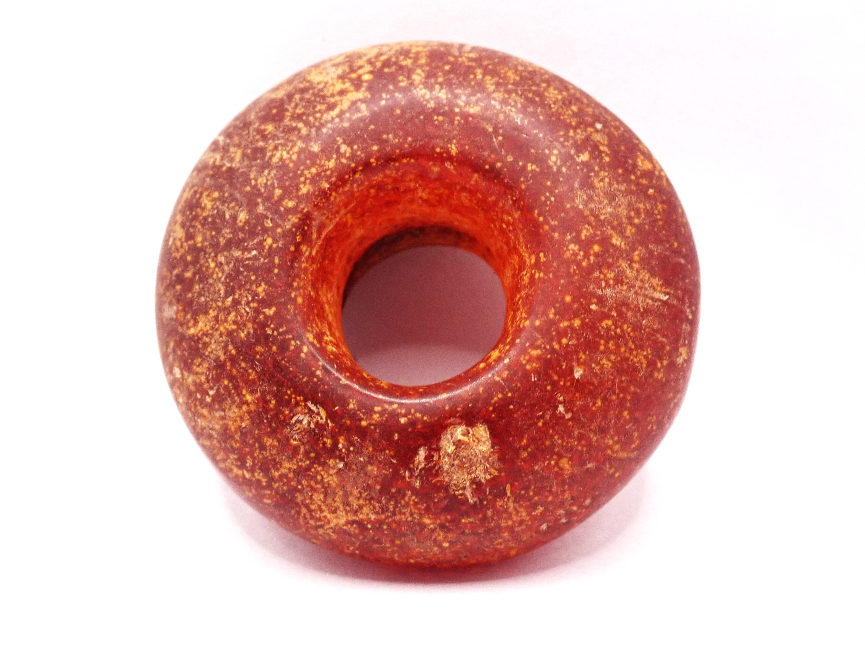
Samian Hunting Scene Bowl (OR 5591) Photograph | Nene Valley Colour Coated Ware Jar Photograph
Cup Photograph (OR 7734) Photograph | Amber Bead (OR 9962) Photograph

Slide 3
Samian Bowl: Samian Ware is a type of shiny, red Roman pottery that was often decorated with pretty patterns and scenes. This bowl is decorated with a hunting scene! This bowl was made in Central Gaul, which we now call France between 150-185 A.D. by a potter named Paternus. | Nene Valley Ware Jar: Nene Valley colour-coated ware is a type of Roman pottery that often has a smooth, dark surface. It was sometimes decorated with painted designs. This jar was made near Durobrivae, which we now call Peterborough in Britannia which we now call England.
Cup: This wine cup is decorated with a black coating called a slip and spirals applied by trailing lines of clay over the body of the vessel, a bit like piping icing over a cake. This cup was made in Central Gaul, which we now call Germany between 150-200 A.D. | Amber Bead: This bead is made from amber. Amber is a mineral made from tree sap that has hardened over millions of years. This bead may have been made in Northern Italia, which we now call Northern Italy and Austria.
Print these A5, cut out and place back-to-back with corresponding photograph
before laminating

Slide 4
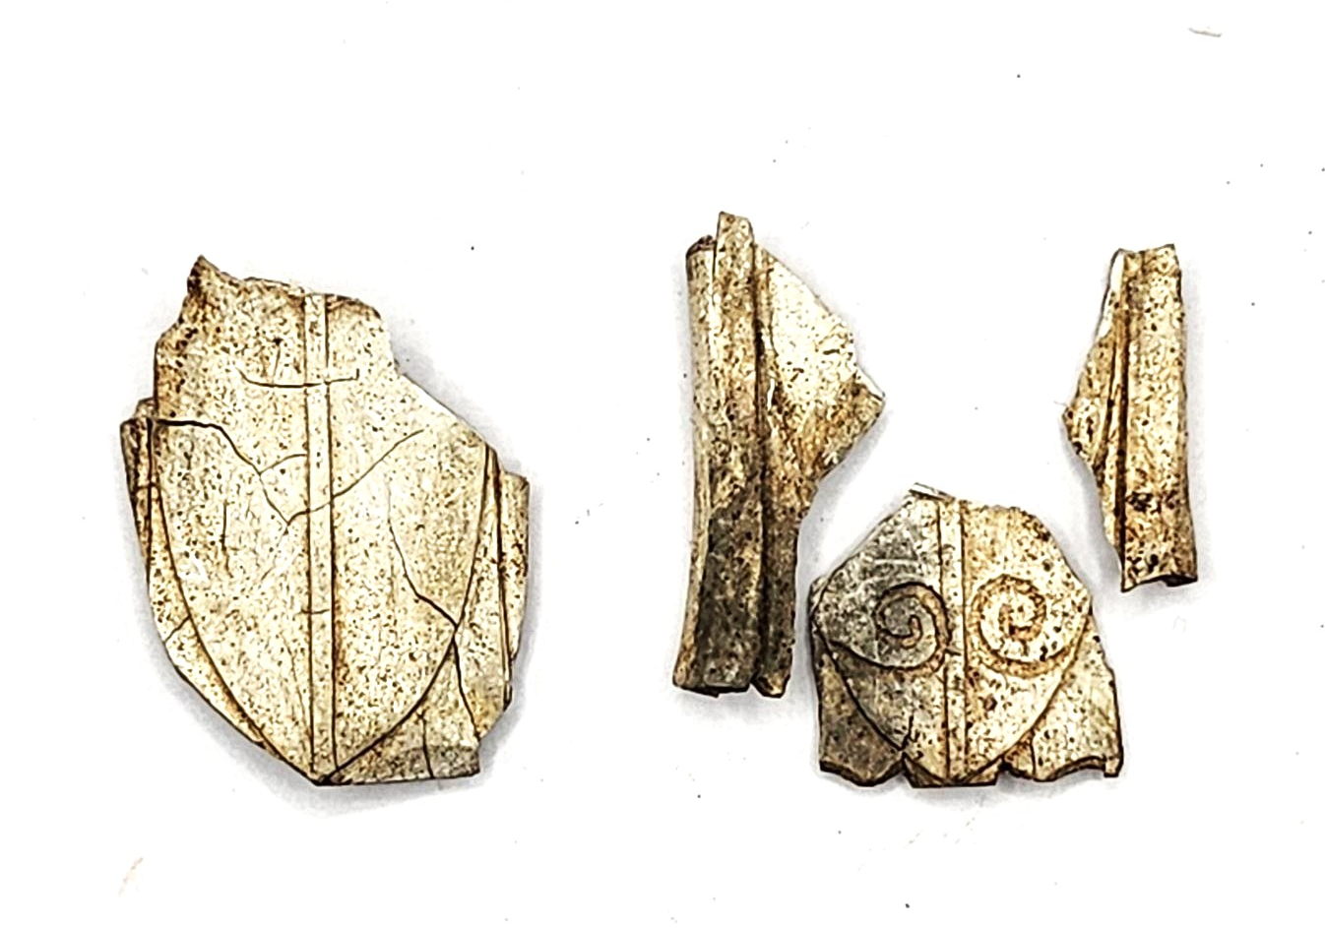
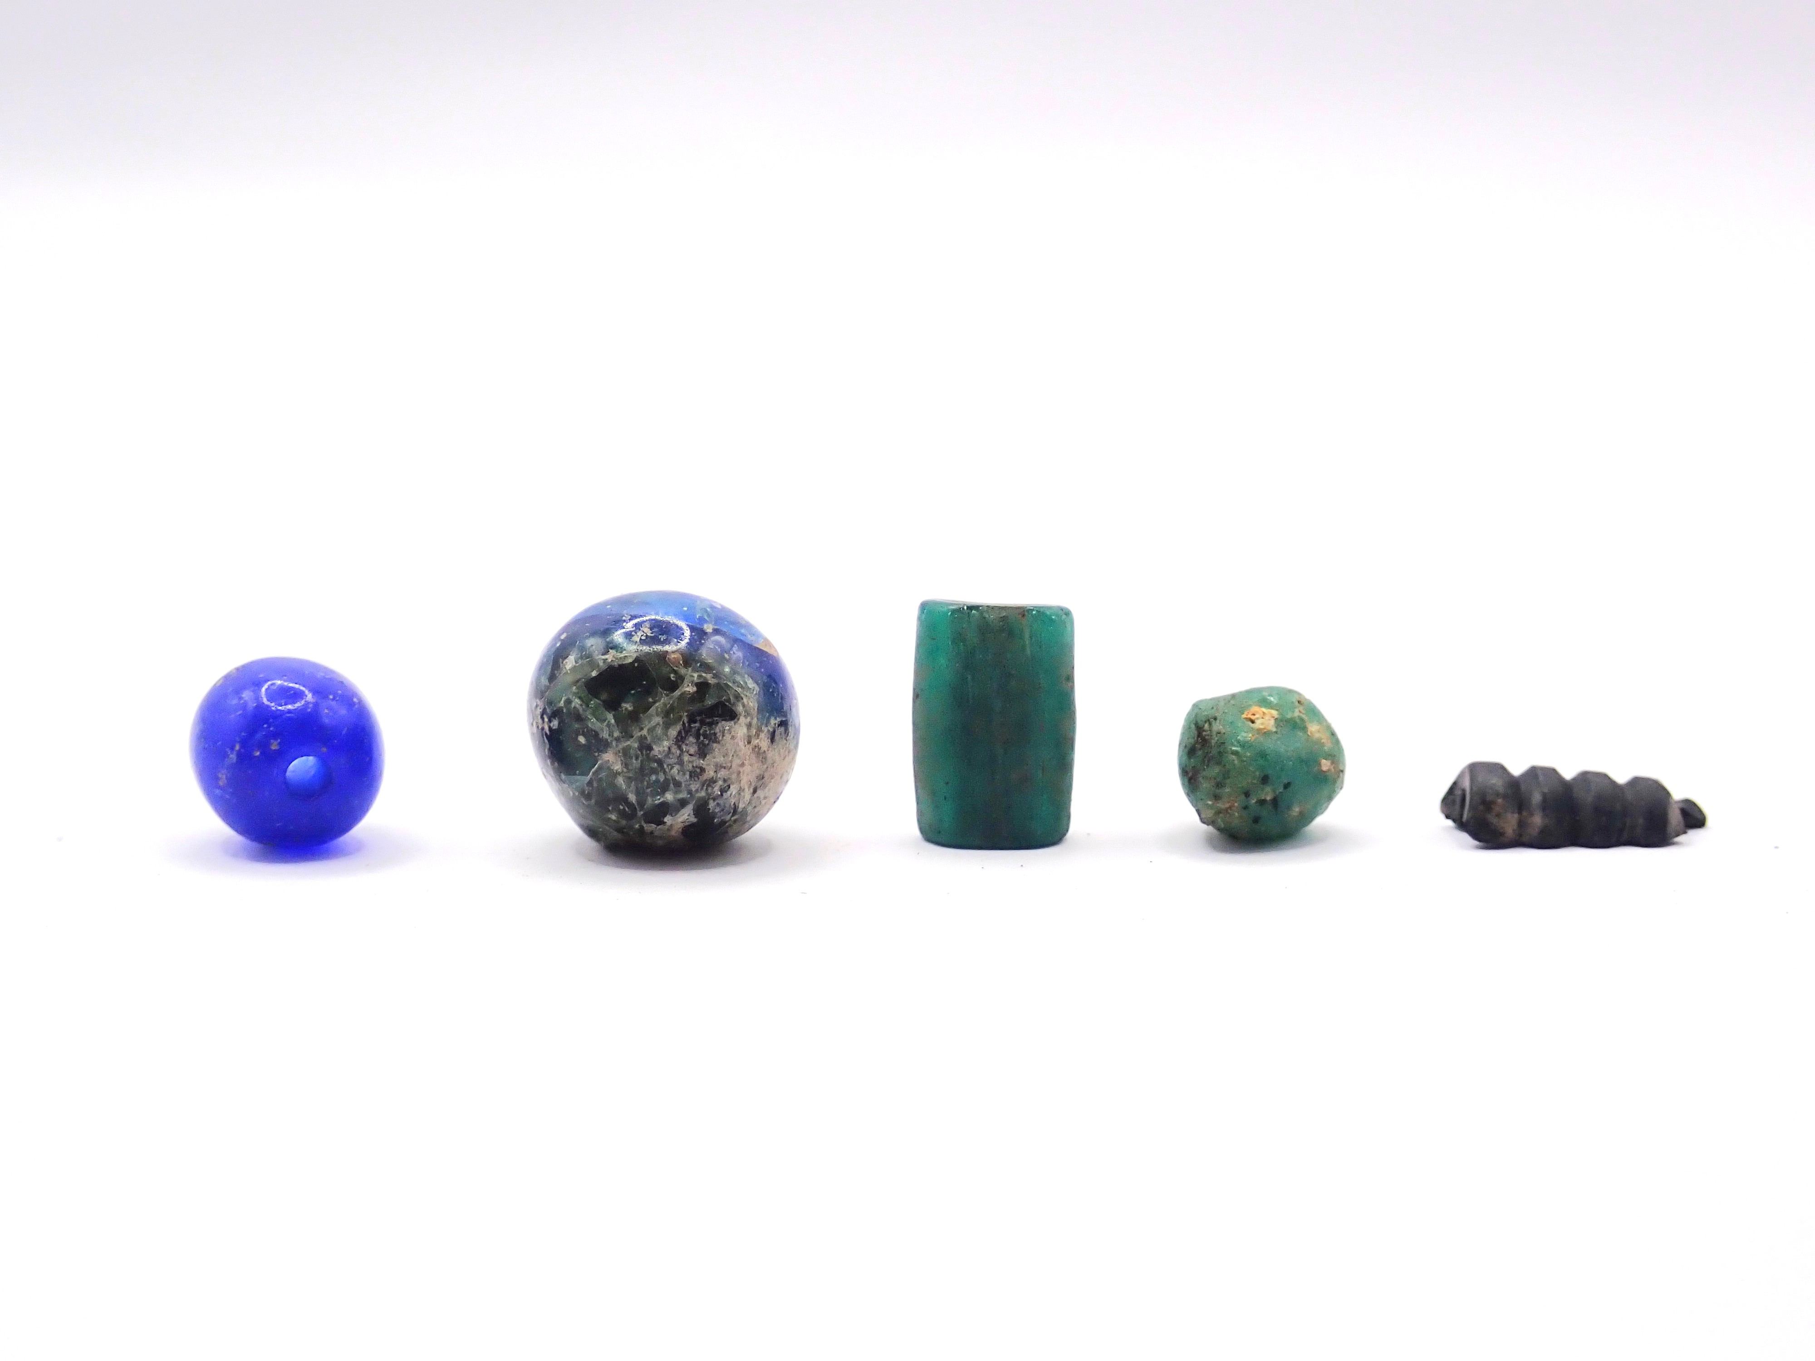
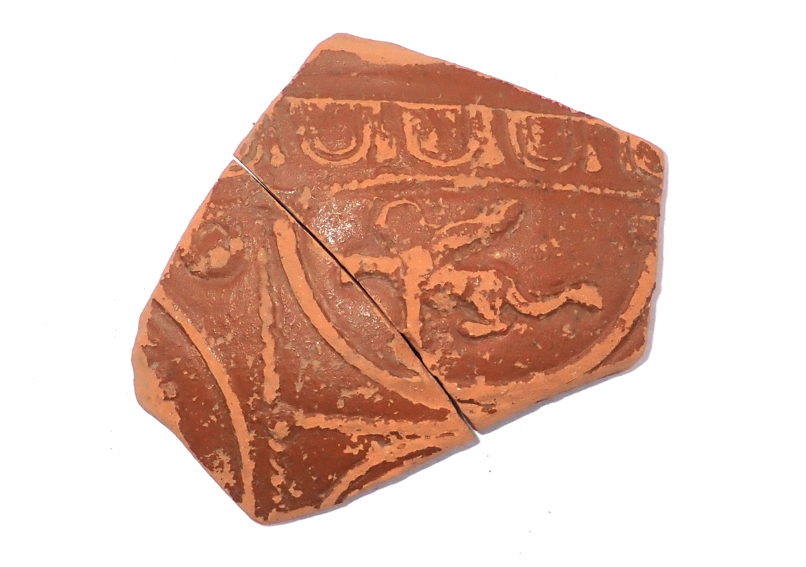
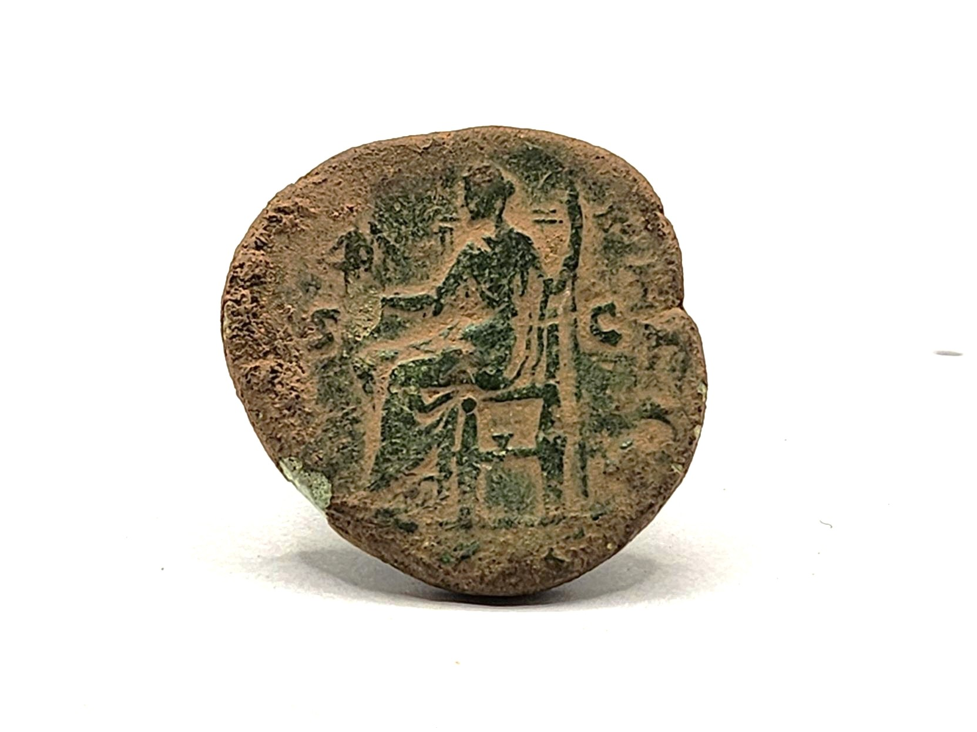
Bone Chape (OR 7835) Photograph | Beads Photograph
Samian Sphinx Photograph | Coin (OR 5033) Photograph

Slide 5
Bone Chape: A bone chape is a piece of bone used to strengthen or decorate the end of a dagger sheath. It helped protect the tip and often had simple designs carved into it. This chape is like one found in Eastern Gaul, which we now call Germany. | Beads: Roman beads were used to make a variety of different types of jewellery, especially necklaces and bracelets. They come in lots of shapes, sizes, and materials. Some of these beads will have been made in Dacia, Moesia, and Thrace, which we now call Romania and Bulgaria.
Samian Sphinx: This piece of Roman pottery that was decorated with a picture of a sphinx. The sphinx is a symbol commonly found in Ancient Egypt. This piece was made in Gaul, but is likely inspired by Egyptus, which we now call Egypt. | Coin: This coin depicts Faustina the Younger and is from 161-176 A.D. Roman coins like this were used across the whole empire. This coin was likely made in Central Italia, which we now call Italy.
Print these A5, cut out and place back-to-back with corresponding photograph
before laminating

